Slide 1
Equations and Inequalities
Algebra 2
Chapter 1
Notes:
Algebra II 1

Slide 2
This Slideshow was developed to accompany the textbook
  Larson Algebra 2
  By Larson, R., Boswell, L., Kanold, T. D., & Stiff, L.
  2011 Holt McDougal
Some examples and diagrams are taken from the textbook.
Slides created by
Richard Wright, Andrews Academy
rwright@andrews.edu

Slide 3
1.1 Apply Properties of Real Numbers
Real Numbers
Rational Numbers – Can be written as fractions
Integers – No decimals
Whole Numbers – Non-negative
½ = 0.5
2/3 = .666…
-3
5
0
0
1
2
Irrational Numbers – Cannot be written as fraction
$\sqrt{2}$ =
1.414…
√2 =
1.414…
π =
3.14…
$−\sqrt{5}$ =
-2.24…
−√5 =
-2.24…

Slide 4
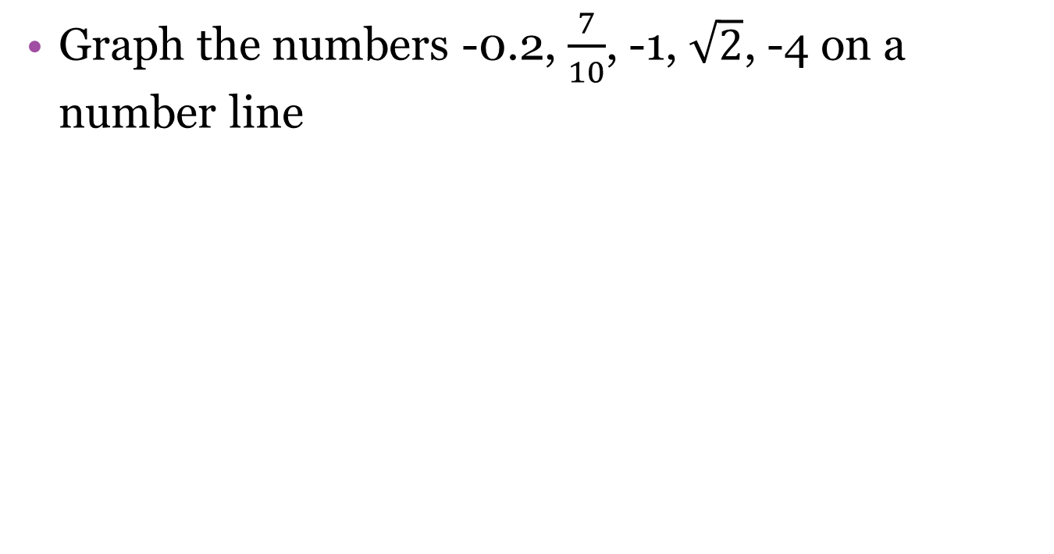
1.1 Apply Properties of Real Numbers
Graph the numbers -0.2, $\frac{7}{10}$, -1, $\sqrt{2}$, -4 on a number line
-4
-3
-2
-1
0
1
2

Slide 5
1.1 Apply Properties of Real Numbers
Property
Addition
Multiplication
Closure
a + b is a real number
ab is a real number
Commutative
a + b = b + a
ab = ba
Associative
(a + b) + c = a + (b + c)
(ab)c = a(bc)
Identity
a + 0 = a
a • 1 = a
Inverse
a + (-a) = 0
a • 1/a = 1
Distributive
a(b + c) = ab + ac
Definition of Subtraction
a – b = a + (-b)
Definition of Division
a ÷ b = a • 1/b
Identify the illustrated property
(2 • 3) • 9 = 2 • (3 • 9)
15 + 0 = 15
4(5 + 25) = 4(5) + 4(25)
Notes:
Associative prop of multiplication
Identity prop of addition
Distributive prop

Slide 6
1.1 Apply Properties of Real Numbers
Use properties to show that each statement is true and justify each step.
  b • (4 ÷ b ) = 4
  3x + (6 + 4x) = 7x + 6
Notes:
b • (4 ÷ b ) = b • (4 • 1/b) def of division
= b • (1/b • 4) commutative prop of multiplication
= (b • 1/b) • 4 associative prop of multiplication
= 1 • 4 inverse prop of multiplication
= 4 identify prop of multiplication
2. 3x + (6 + 4x) = 3x + (4x + 6) commutative prop of addition
= (3x + 4x) + 6 associative prop of addition
= (3 + 4)x + 6 distributive prop
= 7x + 6 addition

Slide 7
1.1 Apply Properties of Real Numbers
Unit analysis
  When you deal with real-life (word) problems you should check your units to make sure your calculation makes sense
You work 6 hours and earn $69. What is your earning rate?
How long does it take to travel 180 miles at 40 miles per hour?
Notes:
$69/6 hours = 11.5 $/hr
180 mi / (40 mi / hr) = 4.5 hr

Slide 8
1.1 Apply Properties of Real Numbers
Convert the following units
  150 yards to feet
  16 years to seconds
6 #3-21 odd, 25-29 odd, 33, 35, 41-45 odd, 49, 53, 59, 61 + 3 choice = 25
Notes:
150 yds (3 ft/ 1 yd) = 450 ft
16 yrs (365.25 days/yr)(24 hours/day)(60 min/hr)(60 sec/min) = 504,921,600 sec

Slide 9
Homework Quiz
1.1 Homework Quiz

Slide 10
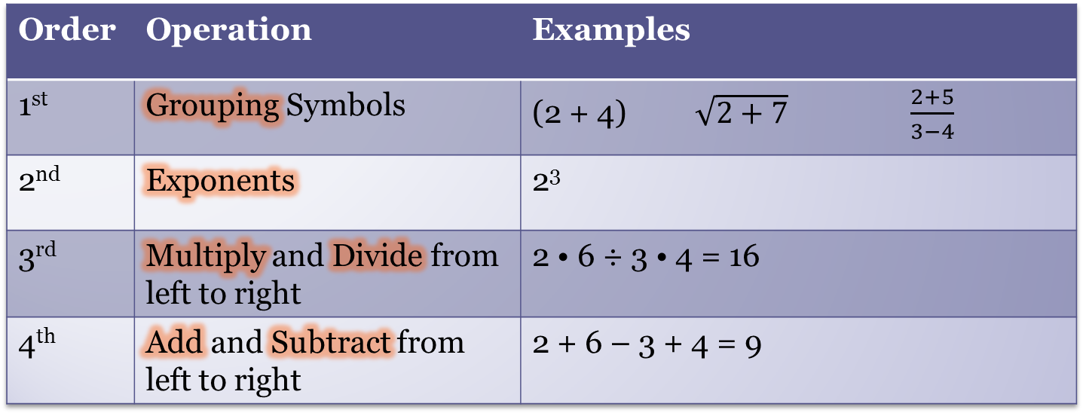
1.2 Evaluate and Simplify Algebraic Expressions
Order of Operations
Order | Operation | Examples
1st | Grouping Symbols | (2 + 4) $\sqrt{2+7}$ $\frac{2+5}{3−4}$
2nd | Exponents | 2³
3rd | Multiply and Divide from left to right | 2 • 6 ÷ 3 • 4 = 16
4th | Add and Subtract from left to right | 2 + 6 – 3 + 4 = 9
Notes:
Please Excuse My Dear Aunt Sally
Parentheses Exponents Multiply Divide Add Subtract

Slide 11
1.2 Evaluate and Simplify Algebraic Expressions
Evaluate
  -2⁶
  (-2)⁶
  5x(x – 2) when x = 6
Notes:
-64
64
5(6)(6-2) = 5(6)(4) = 120

Slide 12
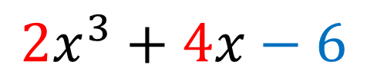
1.2 Evaluate and Simplify Algebraic Expressions
Algebraic expressions written as sums
To add or subtract algebraic expressions, combine like terms by adding the coefficients.
  2x + (-1) + 5x = 7x – 1
variable term
constant term
$$2x^{3}+4x−6$$
coefficients

Slide 13
1.2 Evaluate and Simplify Algebraic Expressions
Simplify
  2n – 1 + 6n + 5
  3p³ + 5p² – p³
  8(x – 3) – 2(x + 6)
13 #1-73 every other odd + 6 choice = 25
Notes:
8n + 4
2p³ + 5p²
8x – 24 – 2x – 12 = 6x – 36

Slide 14
Homework Quiz
1.2 Homework Quiz

Slide 15
1.3 Solve Linear Equations
The Golden Rule
  Do unto others as you would have them do unto you.
The Golden Rule of Algebra
  Do unto one side as you have done unto the other side.
Notes:
Both sides of the equations must stay balanced.

Slide 16
1.3 Solve Linear Equations
General way to solve linear equations
  Get the variables all on one side
  Get everything away from the variables
Always follow the Golden Rule!!!

Slide 17
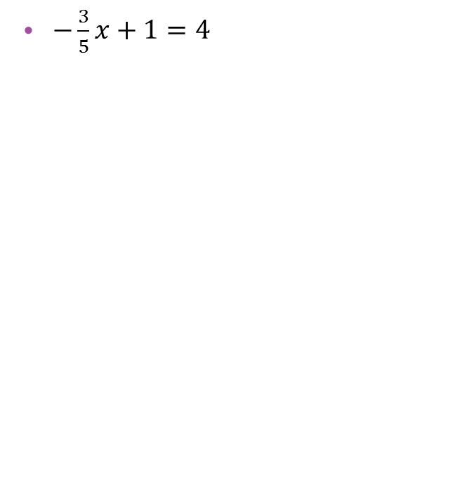
1.3 Solve Linear Equations
Solve
  4x + 9 = 21
  $−\frac{3}{5}x+1=4$
Notes:
4x + 9 = 21 → 4x = 12 → x = 3
-(3/5)x + 1 = 4 → -(3/5)x = 3 → x = -5

Slide 18
1.3 Solve Linear Equations
Solve
  -2x + 9 = 2x – 7
  3(x + 2) = 5(x + 4)
Notes:
-2x + 9 = 2x – 7 → -4x + 9 = -7 → -4x = -16 → x = 4
3(x + 2) = 5(x + 4) → 3x + 6 = 5x + 20 → -2x + 6 = 20 → -2x = 14 → x = -7

Slide 19
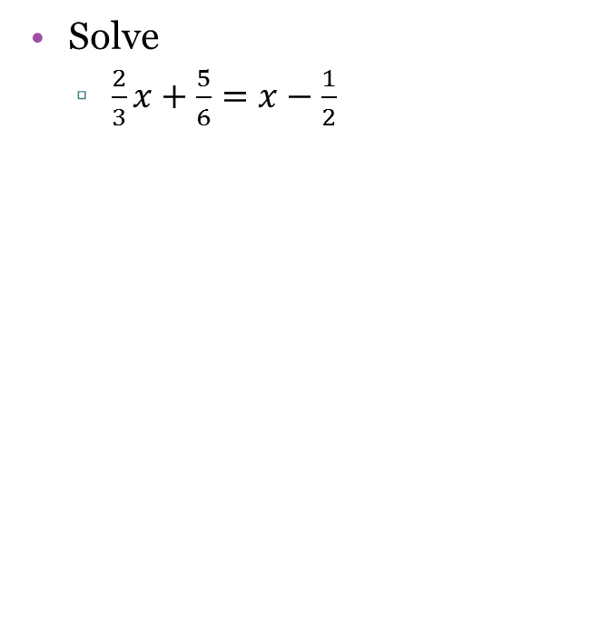
1.3 Solve Linear Equations
Solve
  $\frac{2}{3}x+\frac{5}{6}=x−\frac{1}{2}$
Notes:
2/3 x + 5/6 = x – ½ → 2/3 x – 3/3 x + 5/6 = -1/2 → -1/3 x = -1/2 – 5/6 → -1/3 x = -3/6 – 5/6 → -1/3 x = -8/6 → x = 4

Slide 20
1.3 Solve Linear Equations
A real estate agent’s base salary is $22,000 per year. The agent earns a 4% commission on total sales. How much must the agent sell to earn $60,000 in one year?
21 #3-75 every other odd + 6 choice = 25
Notes:
Total money = base salary + commission percent • sales
60000 = 22000 + 0.04x
38000 = 0.04x
X = 950,000

Slide 21
Homework Quiz
1.3 Homework Quiz

Slide 22
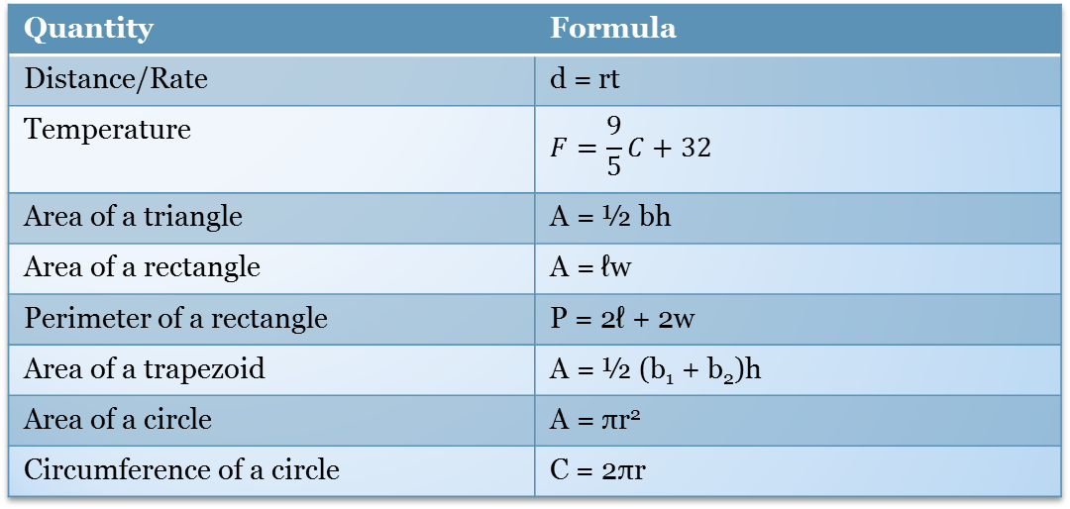
1.4 Rewrite Formulas and Equations
Common Formulas (Quiz Tomorrow!)
Quantity | Formula
Distance/Rate | d = rt
Temperature | $$F=\frac{9}{5}C+32$$
Area of a triangle | A = ½ bh
Area of a rectangle | A = ℓw
Perimeter of a rectangle | P = 2ℓ + 2w
Area of a trapezoid | A = ½ (b₁ + b₂)h
Area of a circle | A = πr²
Circumference of a circle | C = 2πr

Slide 23
1.4 Rewrite Formulas and Equations
Solve for a variable
  Get the variable on one side of the equals sign and everything else (including other variables) on the other side
Find the radius of a circle with a circumference of 25 feet.
Notes:
C = 2πr → 25 = 2πr → 25/(2π) = r ≈ 4 ft

Slide 24
1.4 Rewrite Formulas and Equations
Solve the perimeter of a rectangle formula for ℓ. Then find the length of a rectangle with width of 7 inches and a perimeter of 30 inches.
Notes:
P = 2ℓ + 2w → P – 2w = 2ℓ → ℓ = (P – 2w)/2
ℓ = (30 – 2(7))/2 = 8 in

Slide 25
1.4 Rewrite Formulas and Equations
Solve the area of a trapezoid formula for h. Then find h if b₁ = 6 in, b₂ = 8 in, and A = 70 in².
Solve for y
  4y – xy = 28
Notes:
A = ½ (b₁ + b₂)h → 2A = (b₁ + b₂)h → (2A)/(b₁ + b₂) = h
h = (2(70))/(6 + 8) = 10 in
y(4 – x) = 28 → y = 28/(4 – x)

Slide 26
1.4 Rewrite Formulas and Equations
A campus bookstore sells T-shirts for $15 each and sweatshirts for $22 each.
  Write an equation for the bookstore’s revenue from selling m T-shirts and n sweatshirts.
  Solve the equation for m.
30 #5, 7, 11-25 odd, 29-39 odd + 4 choice = 20
Notes:
R = 15m + 22n
R – 22n = 15m
m = (R – 22n)/15

Slide 27
Homework Quiz
1.4 Homework Quiz
1.4 Formula Quiz

Slide 28
1.5 Use Problem Solving Strategies and Models
Strategies to solve real-life (word) problems
  Often it is easiest to write an equation in words before you write it in mathese.
  This is called a verbal model.
  You think this way in your head already.
Ways to find a verbal model
  Use a formula
  Look for a pattern
  Draw a diagram

Slide 29
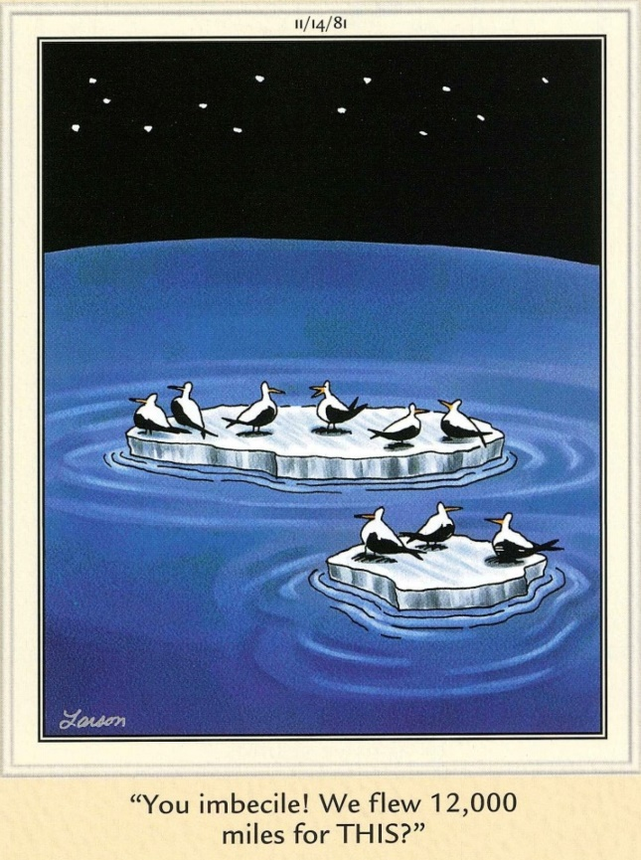
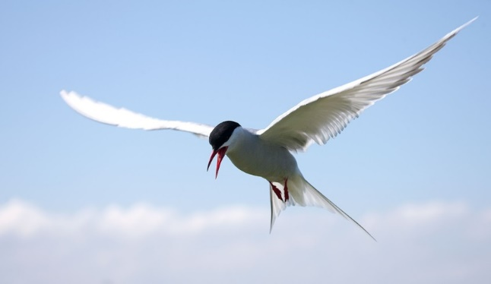
1.5 Use Problem Solving Strategies and Models
An artic tern flies an average speed of 16.7 miles per hour. How long will it take to fly from its winter grounds in Antarctica to its breeding grounds in Greenland, a distance of 12000 miles?
Notes:
Distance = rate • time
12000 mi = 16.7 mi/hr • t
t = 719 hr = 29.9 days

Slide 30
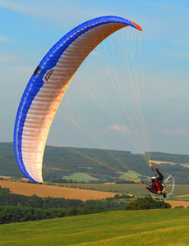
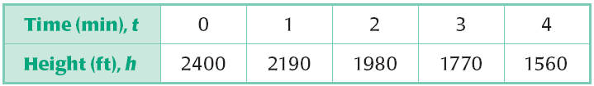
1.5 Use Problem Solving Strategies and Models
PARAMOTORING: The table shows the height h of a paramotorist after t minutes. Find the height of the paramotorist after 8 minutes.
Notes:
Subtracting consecutive heights shows that the paramotorist is losing 210 ft per min.
Height = initial height – rate • time
h = 2400 ft – 210 ft/min • 8 min
h = 720 ft

Slide 31
1.5 Use Problem Solving Strategies and Models
A truck used 28 gallons of gasoline and traveled a total distance of 428 miles. The truck’s fuel efficiency is 16 miles per gallon on the highway and 12 miles per gallon in the city. How many gallons of gasoline were used in the city?
37 #3-33 odd + 4 choice = 20
Notes:
Distance = rate city • gal city + rate highway • gal highway
428 = 12 • x + 16 • (28 – x)
428 = 12 x + 448 – 16 x
-20 = -4x
x = 5 gallons

Slide 32
Homework Quiz
1.5 Homework Quiz

Slide 33
1.6 Solve Linear Inequalities
Inequality
  Similar to an equation, only one side is greater than the other
Inequalities in one variable can be graphed on a number line
  Plot the point on the number line
    Filled dot if equal to; ≤, ≥, =
    Open dot if not equal to; <, >
  Draw an arrow or line covering the part of the number line included by the inequality

Slide 34
1.6 Solve Linear Inequalities
Graph x > -2
Graph -3 ≤ x < 1
Graph x < 1 or x ≥ 2
-3
-2
-1
0
1
2
3
-3
-2
-1
0
1
2
3
-3
-2
-1
0
1
2
3
Notes:
The last two are called compound inequalities

Slide 35
1.6 Solve Linear Inequalities
Solving inequalities
  Follow the Golden Rule
  One exception: when you multiply or divide by a negative, reverse the inequality
2 < 4
(-3) 2 < (-3) 4
-6 < -12

Slide 36
1.6 Solve Linear Inequalities
Solve
  4x + 9 < 25
  5x – 7 ≤ 6x
Notes:
4x + 9 < 25 → 4x < 16 → x < 4
5x – 7 ≤ 6x → -7 ≤ x → x ≥ -7
1 – 3x ≥ -14 → -3x ≥ -15 → x ≤ 5

Slide 37
1.6 Solve Linear Inequalities
  1 – 3x ≥ -14

Slide 38
1.6 Solve Linear Inequalities
Solve
  -1 < 2x + 7 < 19
  x + 4 ≤ 9 or x – 3 ≥ 7
Notes:
-1 < 2x + 7 < 19 → -8 < 2x < 12 → -4 < x < 6
x + 4 ≤ 9 or x – 3 ≥ 7
x + 4 ≤ 9 → x ≤ 5
x – 3 ≥ 7 → x ≥ 10
x ≤ 5 or x ≥ 10

Slide 39
1.6 Solve Linear Inequalities
In South Bend, the lowest temperature on record is -22°F in January, 1943, while the highest temperature on record is 109°F in July, 1934. Write the range of temperatures as an inequality. Then write an inequality giving the temperature range in degrees Celsius.
Notes:
-22 ≤ F ≤ 109
-22 ≤ (9/5)C + 32 ≤ 109
-54 ≤ 9/5 C ≤ 77
-30 ≤ C ≤ 42.8

Slide 40
1.6 Solve Linear Inequalities
44 #3-59 every other odd + 5 choice = 20

Slide 41
Homework Quiz
1.6 Homework Quiz

Slide 42
1.7 Solve Absolute Value Equations and Inequalities
Absolute Values
| x | = b
  Distance between x and 0 is b
| x – k | = b
  Distance between x and k is b
Distance from origin to coordinate
In one dimension, turns the number positive

Slide 43
1.7 Solve Absolute Value Equations and Inequalities
There are usually two solutions,
  One for when the expression inside the | | is positive
  One for when the expression inside the | | is negative
Steps to solve
  Write two equations
    Absolute value expression +
    Absolute value expression -
  Solve each equation
  Check your solutions

Slide 44
1.7 Solve Absolute Value Equations and Inequalities
Solve
  | x – 3 | = 10
  | 2x + 5 | = 3x
  | 4x – 1 | = 2x + 9
Notes:
x – 3 = 10 or –(x – 3) = 10
x = 13 or x – 3 = -10
x = 13 or x = -7
2x + 5 = 3x or –(2x + 5) = 3x
5 = x or 2x + 5 = -3x
x = 5 or 5 = -5x
x = 5 or x = -1 (-1 does not check)
4x – 1 = 2x + 9 → 2x – 1 = 9 → 2x = 10 → x = 5
OR
-(4x – 1) = 2x + 9 → -4x + 1 = 2x + 9 → -6x + 1 = 9 → -6x = 8 → x = -8/6 = -4/3

Slide 45
1.7 Solve Absolute Value Equations and Inequalities
Solve absolute value inequalities the same as equations
  Exception: write answer as compound inequality

Slide 46
1.7 Solve Absolute Value Equations and Inequalities
Solve
  | 2x – 7 | > 1
  | 7 – x | ≤ 4
Notes:
2x – 7 > 1 → 2x > 8 → x > 4
OR
-(2x – 7) > 1 → 2x – 7 < -1 → 2x < 6 → x < 3
x < 3 or x >4
7 – x ≤ 4 → -x ≤ -3 → x ≥ 3
OR
-(7 – x) ≤ 4 → 7 – x ≥ -4 → -x ≥ -11 → x ≤ 11
3 ≤ x ≤ 11

Slide 47
1.7 Solve Absolute Value Equations and Inequalities
Ostrich eggs have an average mass of 1950 grams, with a tolerance of 350 grams. Write and solve an absolute value inequality that describes the mass of ostrich eggs.
Notes:
The distance between the actual weight and the target weight should be less than or equal to the tolerance.
| x – 1950 | ≤ 350
x – 1950 ≤ 350 → x ≤ 2300
OR
-(x – 1950) ≤ 350 → x – 1950 ≥ -350 → x ≥ 1600
1600 ≤ x ≤ 2300

Slide 48
1.7 Solve Absolute Value Equations and Inequalities
55 #7-79 every other odd + 1 choice = 20

Slide 49
Homework Quiz
1.7 Homework Quiz

Slide 50
1.Review
65 #20 choice = 20

